Slide 1
Loops in Python
(For & While)

Slide 2


Loops in Python
In Python, loops are used to execute a block of code repeatedly. The two main types of loops are:
Loops in Python
For Loop
While Loop

Slide 3
For Loop
A for loop is used to iterate over a sequence (like a list, tuple, dictionary, string, or a range of numbers).
Syntax: for variable in sequence:
# Code block
Example with range(): for i in range(5):
print(i) Output: 0
1
2
3
4
Example with a list: fruits = ["apple", "banana", "cherry"]
for fruit in fruits:
print(fruit)

Slide 4
Nested for loop
A nested for loop means placing one for loop inside another. This is useful for iterating over multi-dimensional structures or performing repetitive tasks within a repetitive task.
for outer in range(x):
for inner in range(y):
# code block
Examples
Example 1: Multiplication Table
for i in range(1, 4): # Outer loop
for j in range(1, 6): # Inner loop
print(f"{i} x {j} = {i*j}")
print("----------")

Slide 5
2. While Loop
A while loop repeats as long as a condition is True.
Syntax:
C
Example:
count = 0
while count < 5:
print(count)
count += 1
Output: 0
1
2
3
4

Slide 6
Loop Control Statements
These modify the behavior of loops:
break – exit the loop entirely
continue – skip the rest of the current loop iteration
pass – do nothing (used as a placeholder)

Slide 7
Loop Control Statements
break example:
for i in range(10):
if i == 5:
break
print(i)
continue example:
for i in range(5):
if i == 2:
continue
print(i)

Slide 8
Let’s Practice
# Task 1: Sum of First 10 Natural Numbers

Slide 9
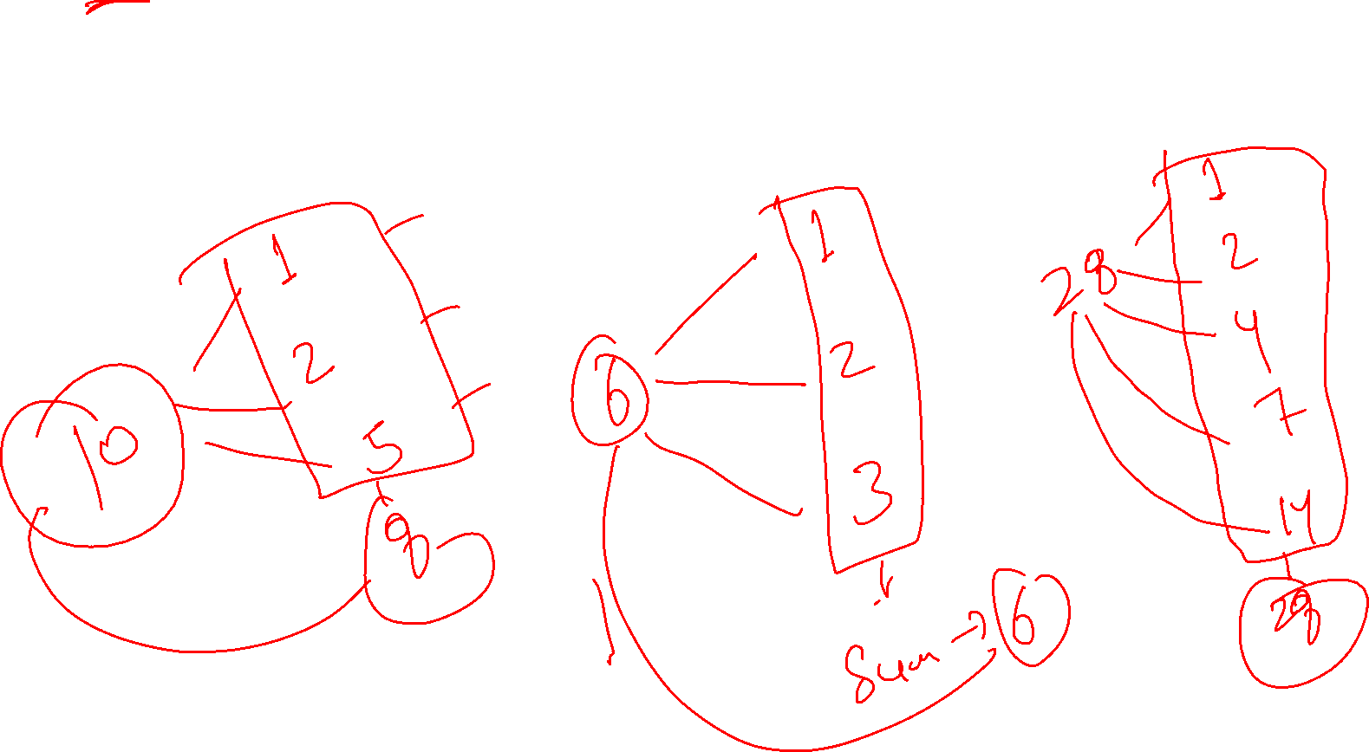
Let’s Practice
# Task 2: Check if a Number is a Perfect Number.

Slide 10
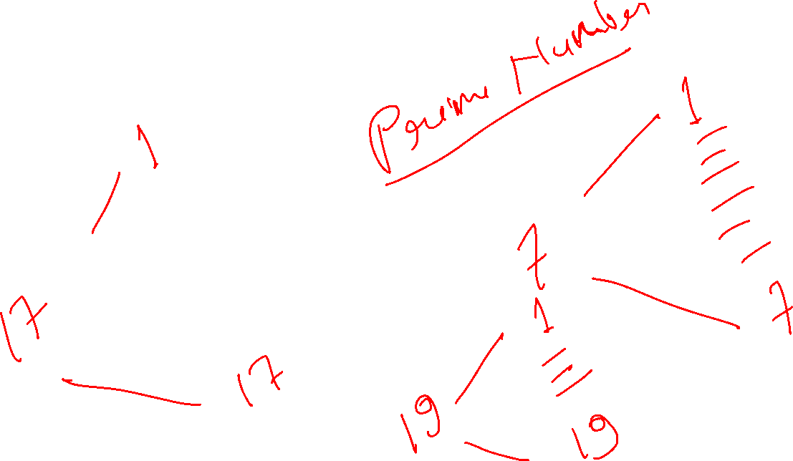
Let’s Practice
# Task 3: Check if a Number is Prime

Slide 11
Let’s Practice
# Task 4: Reverse a Number using while Loop

Slide 12
Let’s Practice
# Task 5: Count the Digits in a Number

Slide 13
Let’s Practice
# Task 6: Right-Angle Triangle of Stars
# Input: n = 5
# Output:
# *
# * *
# * * *
# * * * *
# * * * * *

Slide 14
Let’s Practice
# Task 7: Number Pyramid
# Output:
# 1
# 1 2
# 1 2 3
# 1 2 3 4
n = 4
for i in range(1, n + 1):
for j in range(1, i + 1):
print(j, end=" ")
print()

Slide 15
Let’s Practice
# Task 8: Inverted Star Triangle
# Output:
# * * * * *
# * * * *
# * * *
# * *
# *

Slide 16

Thank You!
www.wscubetech.com

